Slide 1


SQL Server 2016 It Just Runs Faster
slideshare.net http://speakerscore.com/3VZB
http://aka.ms/bobwardms
Bob Ward
Principal Architect
Microsoft, Data Group, Tiger Team
bobward@microsoft.com
@bobwardms, #bobsql
https://blogs.msdn.microsoft.com/bobsql

Slide 2
How did we get here?
Nothing intentionally designed just for EE SKU
Faster I/O, Networks, and Dense Core CPUs
Customer Experience, Benchmarks, XEvent, and xperf
Scalability
Partitioning
More and Larger
Dynamic Response
Improved Algorithms
Parallelism

Slide 3
These just make you faster
100x increased query performance
Columnstore Indexes SQL Server 2012+
In-Memory OLTP
SQL Server 2014+
30x increased throughput

Slide 4
Here is How SQL Server 2016 Just Runs Faster
Core Engine Scalability
Automatic Soft NUMA
Dynamic Memory Objects
SOS_RWLock
Fair and Balanced Scheduling
Parallel INSERT..SELECT
Parallel Redo
DBCC
DBCC Scalability
DBCC Extended Checks
TempDB
Goodbye Trace Flags
Setup and Automatic Configuration of Files
Optimistic Latching
I/O
Instant File Initialization is No Longer Hidden
Multiple Log Writers
Indirect Checkpoint Default Just Makes Sense
Log I/O at the Speed of Memory
Spatial
Native Implementations
TVP and Index Improvements
Columnstore
Batch Mode and Window Functions
Always On Availability Groups
Turbocharged
Better Compression and Encryption
New
New
New
and there is more
New

Slide 5
Core Engine Scalability

Slide 6
Automatic Soft NUMA
30% Gain in DOP workload
1.5x Batches/sec –Session State Workload
25% increase in workload derived from TPC-E
SMP and NUMA machines
SMP machines grew from 8 CPUs to 32 or more and bottlenecks started to arise
Along comes NUMA to partition CPUs and provide local memory access
SQL 2005 was designed with NUMA “built-in”
Most of the original NUMA design had no more than 8 logical CPUs per node
Multi-Core takes hold
Dual core and hyperthreading made it interesting
CPUs on the market now with 24+ cores
Now NUMA nodes are experiencing the same bottleneck behaviors as with SMP
The Answer…. Partition It!
Split up HW NUMA nodes when we detect > 8 physical processors per NUMA node
On by default in 2016 (Change with ALTER SERVER CONFIGURATION)
Code in engine that benefits from NUMA partitioning gets a boost
Spinlocks don’t scale with larger # CPUs
IOCP worker = 1 per NODE so more can help connectivity and batch throughput
Notes:
Other examples of just faster scaling with auto soft NUMA
Dynamic PMO since it can promote first to NODE
SQL 2014 SP2 requires trace flag 8079
You can turn this off with ALTER SERVRER but be aware of this bug as documented in https://support.microsoft.com/en-us/kb/3158710 and fixed in SQL 2016 CU1.

Slide 7
How it Works
4 socket 18 core HT = 4 nodes 144 logical CPUs
Core
Memory Node 0
0
2
4
6
8
10
12
14
16
18
20
22
22
24
26
28
30
32
22
34
More details here
1
3
5
7
9
11
13
15
17
19
21
23
25
27
29
31
33
35
Memory Node 0
Node 0
Node 1
0
2
4
6
8
10
12
14
16
18
20
22
24
26
28
30
32
34
Put physical cores on sequential nodes first for DOP
Avoid putting 2 logical CPUs from same core on same NODE
Node 2
Node 3
1
3
5
7
9
11
13
15
17
19
21
23
25
27
29
31
33
35
Notes:
Using ALTER SERVER for AFFINITY with auto gets interesting. Explain this while looking at ERRORLOG and DMV
Using NODE affinity applies to the hardware node configuration. So in the example above if I affinitize on NODE 0, I’ll get soft nodes 0 and 1 to be active.
CPUs still work on logical CPU numbers. So if I affinitize on 0 and 1, soft numa is still applied but the only schedulers are 0 and 1 on soft nodes 0 and 1. and soft nodes 2 and 3 are offline

Slide 8
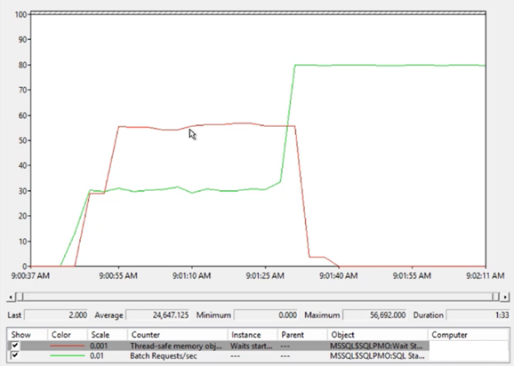
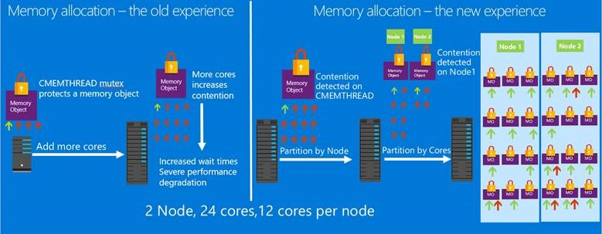
Dynamic Memory Objects
3x Improvement in Memory Allocation with less CPU
CMEMTHREAD waits causing you problems?
SQL Server allocates variable sized memory using memory objects (aka heaps)
Some are “global”. More cores leads to worse performance
Infrastructure exists to create memory objects partitioned by NODE or CPU
Single NUMA (no NODE) still promotes to CPU. -T8048 no longer need
Every time we find a “hot” one, we create a hotfix
It Just Works!
there has to be a better way

Slide 9
Demo Watch us respond to CMEMTHREAD
Notes:
Follow the steps in dynamic_pmo\readme.md file

Slide 10
Parallel Redo
80% increase in standalone recovery redo
Analysis
Redo
Undo
Why go parallel?
Redo has historically been I/O bound
Faster I/O devices means we must utilize more of the CPU
Secondary replicas require continuous redo
Redo is mostly about applying changes to pages
Read the page from disk and apply the logged changes (based on LSN)
Logical operations (file operation) and system transactions need to be applied serially
System Transaction undo required after this before db access
Need a primer in recovery?
Redo Worker Pool
Dirty Page Table (DPT)
PARALLEL REDO TASK
Page 1
LSN 1
LSN 5
PARALLEL REDO TASK
Page 2
LSN 2
PARALLEL REDO TASK
Page 3
LSN 3
LSN 4
Pool = # cores (max 16 per db; 100 for instance)

Slide 11
Demo Redo Goes Parallel
Notes:
Follow the steps in parallel_insert_and_redo\readme.md file

Slide 12
DBCC Is Just Faster

Slide 13
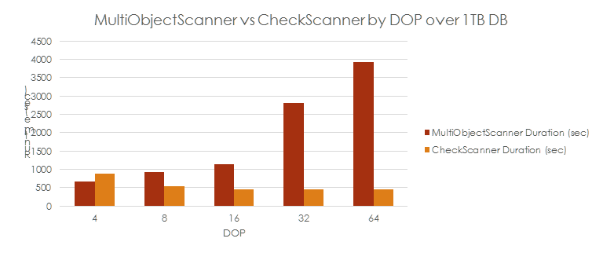
DBCC CHECK* Scalability
7x faster for a 1TB database
Since SQL 2008, we have made CHECK* Faster
Improved latch contention on MULTI_OBJECT_SCANNER* and batch capabilities
Better cardinality estimation
SQL CLR UDT checks
SQL Server 2016 takes it to a new level
MUTLI_OBJECT_SCANNER changed to “CheckScanner”. = “no-lock” approach used
Read-ahead vastly improved
The Results
A “SAP” 1TB db is 7x faster for CHECKDB
The more DOP the better performance (to a point)
2x faster performance with a small database of 5Gb
Get me disk speed. BACKUP to ‘NUL’ test

Slide 14
Tempdb is faster out of the box

Slide 15
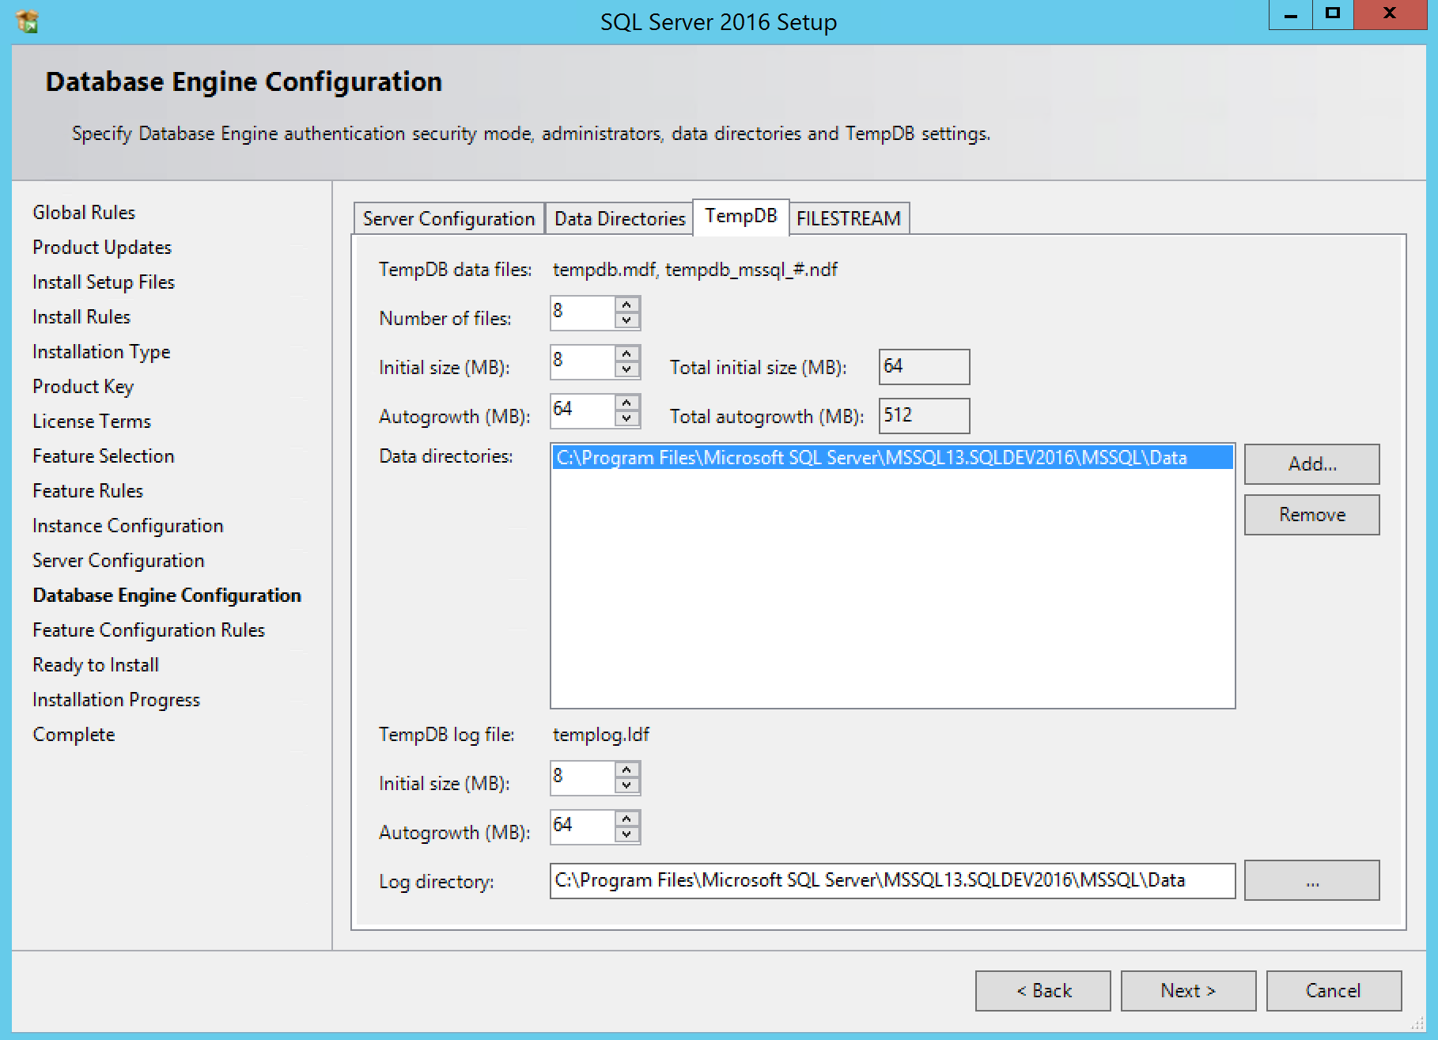
Multiple Tempdb Files: Defaults and Choices
Multiple data files just make sense
1 per logical processor up to 8. Then add by four until it doesn’t help
Round-robin spreads access to GAM, SGAM, and PFS
Remember this is not about I/O
Check out this PASS Summit talk
Autogrow 1 PFS interval
1 per logical CPU up to 8
Spread files across drives
Tlog now 8Mb
256Gb in SQL Server 2017
Notes:
256 GB in 2017

Slide 16
Does It Matter?
2x Faster “Out of the Box” on a 8 CPU machine
Inside Tempdb Talk – PASS Summit 2011
1 CPU – 4 core HT
SQL Server 2016 | SQL Server 2014
68 secs | 155 secs
8 data files @ 8Mb no autgrow for data files
1 data file, encountered autogrow

Slide 17
I/O Is Just Faster

Slide 18
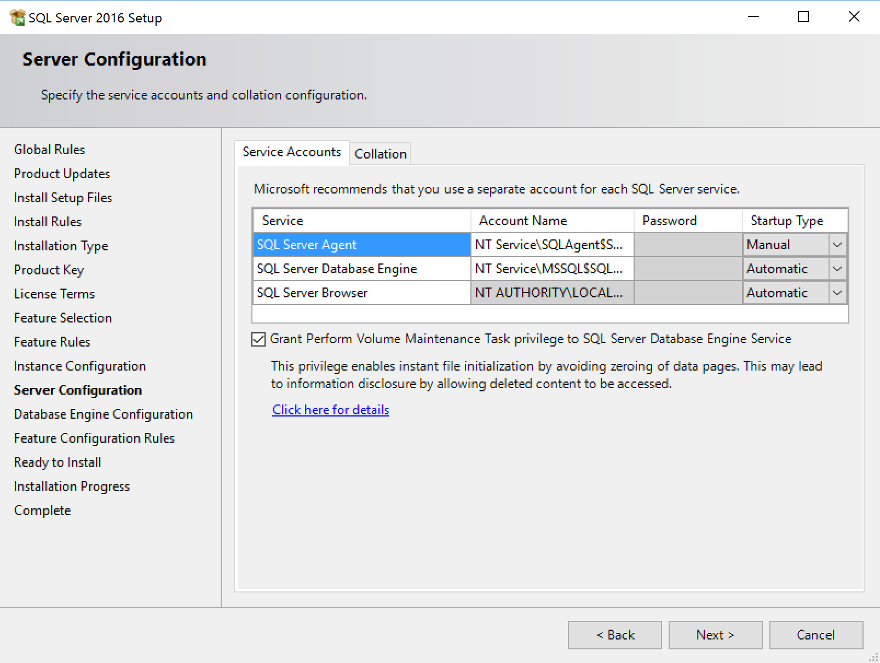
Instant File Initialization
200% Faster
This has been around since 2005
Previously speed to create db is speed to write 0s to disk
Windows introduces SetFileValidData(). Give a length and “your good”
Creating the file for a db almost same speed regardless of size
CREATE DATABASE..Who cares?
You do care about RESTORE and Auto-grow
Is there a catch?
You must have Perform Volume Maintenance Tasks privilege
You can see any bytes in that space previously on disk
Anyone else sees 0s
Can’t use for tlog because we rely on a known byte pattern. Read here
Enables Service SID
This could be a major blocking problem
Windows Admin have this by default
New Installer turns on by default

Slide 19
Persisted Log Buffer
2x speeds over PCI NVMe
Format your NTFS volume with /dax on Windows Server 2016
Create a 2nd tlog file on this new volume on SQL Server 2016 SP1
WRITELOG waits = 0 ms
Tail of the log is now a “memcpy” so commit is fast
The evolution of storage
HDD → SSD (ms)
PCI NVMe SSD (μs)
Tired of WRITELOG waits?
Along comes NVDIMM(ns)
Windows Server 2016 supports block storage (standard I/O path)
A new interface for DirectAccess (DAX)
Watch these videos
Channel 9 on SQL and PMM
NVDIMM on Win 2016 from \\build
Persistent Memory (PM)
Gory Details here
SQL Server 2017 Syntax
ALTER DATABASE <db> SET PERSISTENT_LOG_BUFFER = ON (DIRECTORY_NAME= ‘G:\<data>

Slide 20

Window Functions Go Batch

Slide 21
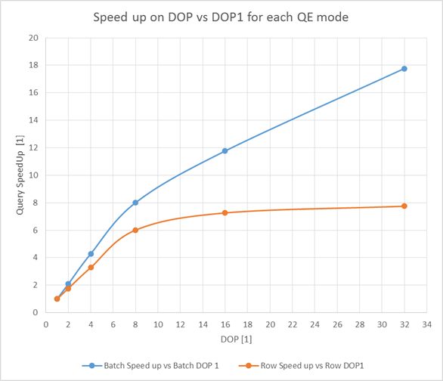
Batch processing → parallelism & scale
Typical cumulative sum aggregate with data partitioning:
SELECT SUM(L_ORDERKEY/100) OVER (
PARTITION BY L_PARTKEY
ORDER BY L_ORDERKEY
ROWS UNBOUNDED PRECEDING AND CURRENT ROW) FROM LINEITEM
Learn Window Functions from Itzik
Batch Mode Fundamentals
Notes:
2 min

Slide 22
Demo The New Windows Aggregate Operator
Notes:
Follow the steps in tempdb\readme.md

Slide 23
Always On Availability Groups Turbocharged

Slide 24
A Better Log Transport
The Drivers
Customer experience with perf drops using sync replica
We must scale with faster I/O, Network, and larger CPU systems
In-Memory OLTP needs to be faster
AG drives HADR in Azure SQL Database
Faster DB Seeding speed
95% of “standalone” speed with benchmarks for a 1 sync replica
HADR_SYNC_COMMIT latency at < 1ms with small to medium workloads
Our code in some cases was the bottleneck

Slide 25
A New, Streamlined Approach
Reduce Number of Threads for the Round Trip
15 worker thread context switches down to 8 (10 with encryption)
Improved Communication Path
LogWriter can directly submit async network I/O
Pool of communication workers on hidden schedulers (send and receive)
Stream log blocks in parallel
Multiple Log Writers on Primary and Secondary
Parallel Log Redo
Reduced Spinlock Contention and Code Efficiencies

Slide 26
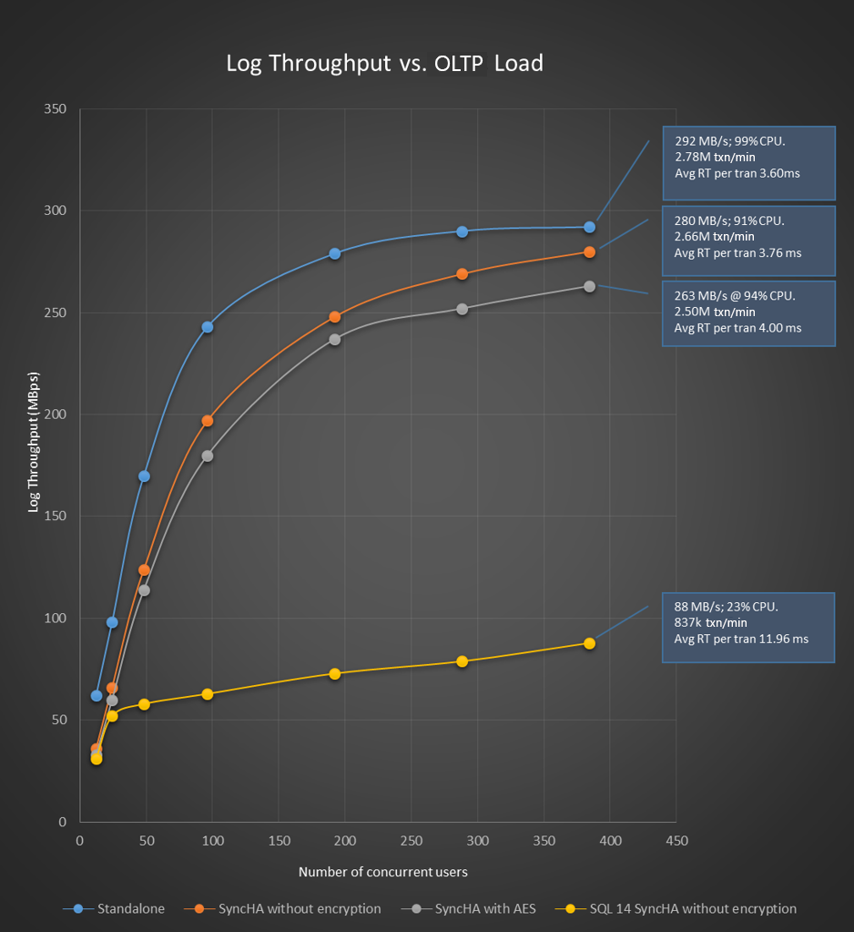
Always On Turbocharged
95% of Standalone
The Results
1 sync HA replica at 95% of standalone speed
90% with 2 replicas
With encryption 90% of standalone
85% at 2 replicas
Sync Commit latency <= 1ms
The Specs
Haswell Processor 2 socket 18 core (HT 72 CPUs)
384GB RAM
4 x 800Gb SSD (Striped, Log)
4 x 1.8Tb PCI SSD (Data)

Slide 27







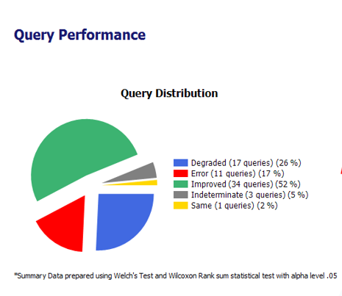
Migration to Meet your Needs
DEA
capture prod workload
Other
Database
Upgrade
Migration
replay
A’
SQL 2008 Instance
B
SQL 2016 Instance
Extensive tracing
Extensive tracing
Source
Legacy
Statistical
Analysis
Comparison
Reports
Target
Modern
Windows Azure
Windows Azure
Analyze Results
Tool(s)
DMA
DMA
SSMA

Slide 28
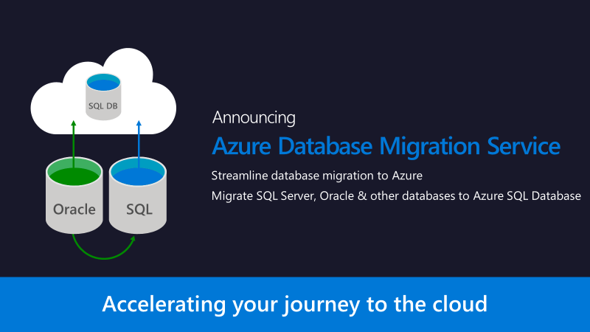

Slide 29
SQL Server 2017
Automatic Plan Correction
Running faster on SQL Server Linux
A faster Indirect Checkpoint
Adaptive Query Processing

Slide 30
We’ve blogged about these…
Larger Data File Writes
Log Stamping Pattern
Column Store uses Vector Instructions
BULK INSERT uses Vector Instructions
On Demand MSDTC Startup
A Faster XEvent Reader

Slide 31
Here are ones we need to brag blog about….
Default database sizes
Very Large memory in Windows Server 2016
TDE using AES-NI
Sort Optimization
Backup compression
SMEP
Query Compilation Gateways
In-Memory OLTP Enhancements

Slide 32
Resources…
It Just Runs Faster Blog Posts - http://aka.ms/sql2016faster
SQLCAT Sweet16 Blog Posts
What’s new in the Database Engine for SQL Server 2016
slideshare.net http://speakerscore.com/3VZB
http://aka.ms/bobwardms

Slide 33
Bonus Material

Slide 34
Multiple Log Writers
In-memory OLTP benchmarks push log from 600 to 900Mb/sec
AG replica gains 4x log throughput
One LogWriter for all Databases for Log Writes
Multiple workers filling up log cache
LogWriter signaled via queue to write out log blocks
Faster I/O Means Disk is no Longer a Bottleneck
Disk is fast enough that LogWriter could be the bottleneck
If LogWriter is processing the completion routine, then it can’t service the queue
Seen in Hekaton and AG Secondary scenarios with fast disk systems
For Scale, Just Add More of Them
We will add one LW for each NUMA node up to 4 (point of diminishing returns)
On hidden scheduler and all on NODE 0
Delayed durability could be slower. Fix available for SQL 2016 CU1
Notes:
For testing purposes, can you disable multiple LW with trace flag 9038 at startup. This is undocumented and not supported for production use (except by direction of Microsoft).

Slide 35
Fair and Balanced Scheduling
Workers naturally yield or run to their quantum
Quantum = 4ms (SOS_SCHEDULER_YIELD). Just get back on the scheduler and go
Naturally = waiting on I/O, latch, lock. When I’m done waiting I still have to wait for scheduler hog.
That’s not fair
Workers who use their entire quantum get more scheduled time
Why should we be fair?
We don’t want heavy CPU workloads to greatly disfavor others
The starved worker could be holding important resources
What is the starved worker is an important system task?

Slide 36
SOS_RWLock gets a new design
Core Synchronization Primitive used in the Engine
Used by various places in the code to implement multiple readers and a single writer
Not visible as a wait_type. You will see some other wait_type (Ex. COMMIT_TABLE)
Uses built-in SOS “Events” to wait
Learn from Hekaton and Latching
Use “interlock” instructions to set “mode”
If there is no contention (only readers) no need to do more work
Just increment the number of readers
We use this in Many Places in the Engine
Finding best scheduler, UCS, HADR, Metadata lookups, QDS, FT, ….
For “reader” scenarios, less collisions, lower CPU, better throughput
SOS_RW in
dm _os_spinlock_stats
Only Readers = no spinlock stats
https://blogs.msdn.microsoft.com/bobsql/2016/07/23/how-it-works-reader-writer-synchronization/

Slide 37
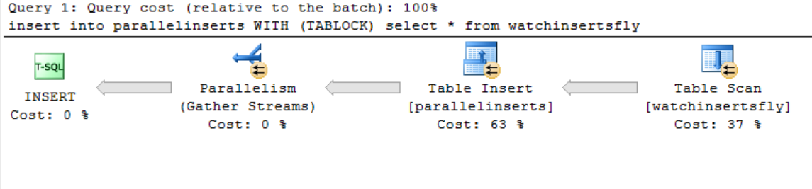
Parallel INSERT..SELECT
300% performance improvement over serial
We did it for SELECT..INTO. Why not INSERT..SELECT?
Only for heaps (and CCI)
TABLOCK hint (required for temp tables starting in SP1)
Read here for more restrictions and considerations
This is really parallel page allocation
Minimally logged. Bulk allocation
There is a DOP threshold
Database Page
Database Page
Database Page
Database Page
Database Page
Database Page

Slide 38
DBCC CHECK* Extended Checks
Some Data Requires “Extended” Logical Checks
Filtered indexes
Persisted computed columns
UDT columns
UDT columns based on CLR assemblies
This can Dramatically Slow Down CHECK*
These checks can be just as expensive as physical checks for a large database
PHYSICAL_ONLY was the only workaround
SQL Server 2016 by Default Skips these Checks
We have enhanced the EXTENDED_LOGICAL_CHECKS option if you want to check these
Filtered index checks are really “just faster” by skipping rows that don’t qualify for the index

Slide 39
Indirect Checkpoint
4TB Memory = ~500 million SQL Server BUF structures for older checkpoint
Indirect checkpoint for new database creation dirties ~ 250 BUF structures
A new Method Based on Dirty Pages vs Log Records
Introduced in SQL Server 2012
Used by setting a target recovery time. It is now the default of 60 in SQL Server 2016
Automatic Checkpoint (Recovery Interval)
Uses log record formula to determine when to trigger an automatic checkpoint
Sweeps the entire BUF array looking for dirty pages to write
Avoid sorted lists to ensure disk elevator seek issues don’t starve other I/O
All types of throttling mechanisms exist
“Bursty” high I/O impact = Not reliable recovery interval
Indirect Checkpoint
New TARGET_RECOVERY_TIME database option (> 0 enabled)
Default for SQL Server 2016 new databases
Consistent I/O impact = reliable recovery target
BACKGROUND worker RECOVERY_WRITER for “automatic” (DIRTY_PAGE_POLL wait)
Keep a list of dirty pages. When triggered, uses a sorted list of dirty pages to issue I/O
Manual and Internal checkpoints use indirect if “enabled”
Buffer Manager:Background writer pages/sec
or trace flag 3504
Target based on page I/O telemetry
Upgraded db are still OFF
Upgraded servers from RC bulid don’t set model

Slide 40
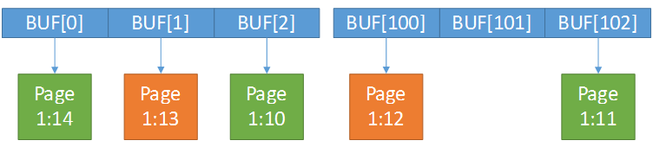
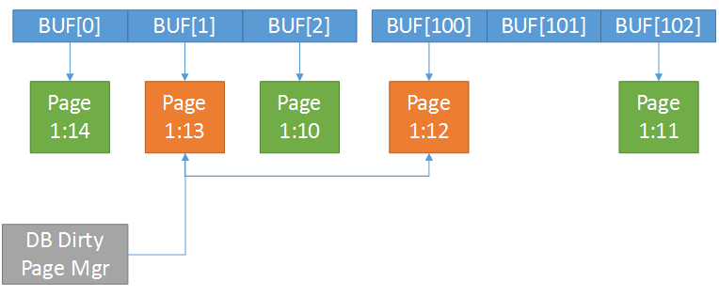
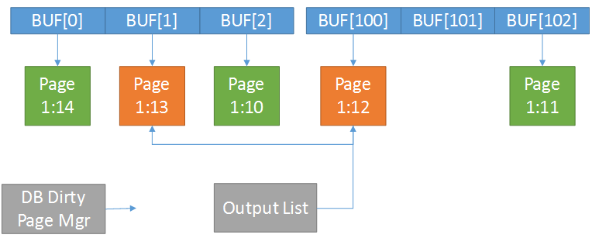
Indirect Checkpoint
4TB Memory = ~500 million SQL Server BUF structures for older checkpoint
Indirect checkpoint for new database creation dirties ~ 250 BUF structures
“Older” Checkpoint
CHECKPOINT
Sweep BUF array. If page dirty, use WriteMultiple method to write out dirty pages “near us”
Dirty pages
Indirect Checkpoint
RECOVERY_WRITER
(2016 default)
New WriteMultiple of 1Mb
As pages are marked dirty, add to a dirty page list
Use a separate sorted list and WriteMultiple
Notes:
If you set a target recovery interval > 0 (default for 2016), any manual or internal checkpoint uses indirect checkpoint
Indirect checkpoint can be more accurate for redo since we base our calculations on recorded telemetry for i/O from bpool

Slide 41
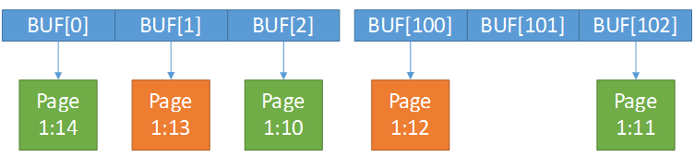
Larger Data Writes
The WriteMultiple Method
The Engine uses WriteFileGather to write out database pages
It must be contiguous on disk
< SQL Server 2016 we max at 32 pages to write at one time (256Kb) “forwards” and “backwards”
SQL Server 2016 use a max of 128 pages (1Mb)
Used for LazyWriter, Checkpoint, and Eager writes (bulk insert and select into)
Fewer Larger Writes can be Faster
This is almost always the case for today’s SSD drives
Allows SSDs to avoid read-modify-writes and parallelize I/O
Works Better with Azure Blog Storage
Notes:
Be aware of Eager Write Leapfrogging

Slide 42
Stamping the Log
The Transaction Log is always Initialized with 0s
We can’t use Instant File Initialization (IFI) for tlog so we can recognize the “end of the log”. Read more here
Disk Vendors/Storage Systems want More with Less
Along comes the concept of thin provisioning
Along comes the concept of data deduplication (popular choice for Azure VM)
Here is the Problem
We initialize the log with 0s
These new storage techniques may result in much of the space of tlog getting reclaimed
When we need to use that part of the log, the storage system must allocate new space
Could result in synchronous I/O or even of space errors
Our solution
We initialize the log with byte pattern of 0xC0
We’ve used this with Azure SQL Database since 2014
Avoid putting SQL database files on these types of storage or file system options

Slide 43
Goodbye Trace Flags
Tempdb = Frequent Database Page Allocations/Deallocations
Frequent allocations/deallocations require latch synchronization to GAM, SGAM, and PFS pages
Mixed extents cause hot SGAM (especially for small tables)
Pages allocated using proportional fill + round-robin when multiple files exist
When using multiple files, critical to keep all files the same size to promote smooth round robin
Autogrow difficult to control for tempdb
Trace flags developed to help
SQL Server 2016, Trace Flags Behavior now Default for Tempdb
Uniform extent ON is default for all databases. MIXED_PAGE_ALLOCATION database option to turn OFF
Autogrow for all files OFF for user databases by default. Use AUTOGROW_ALL_FILES db option to turn ON
-T1118 – Force uniform extents
-T1117 – Autogrow all files in FG together

Slide 44
Tempdb Optimistic Latching
After all of that, you still may face Latch Contention
Usually on system tables
We have made some fixes in the past for specific scenarios. Example in this article.
The Problem and Solution
Assume EX_LATCH but may not need to make changes
Now acquire SH_LATCH. If we need to make the change, then acquire EX_LATCH
Spread the solution
We fixed specific tempdb system tables based on customer reported problems
Now we just fix all other system tables involved in tempdb create/drop

Slide 45
Dynamic Worker Pool
docs on this topic
Expanded Worker Pools and Usage
Anytime you see “multiple threads” it usually means we use these worker pools
You may see these as command = XTP_THREAD_POOL or XTP_PREEPMTIVE_TASK
Examples
Offline Checkpoint
Log Apply
Merge
Pools should get no bigger than # logical CPUs and they have a timeout

Slide 46
Spatial is Just Faster
200x Faster
Spatial Data Types Available for Client or T-SQL
Microsoft.SqlServer.Types for client applications (Ex. SQLGeography)
Provided data types in T-SQL (Ex. geography) access the same assembly/native DLL
SQL 2016 changes the path to the “code”
These transitions for a large number of rows chew up CPU
SQL Server 2014
Unmanaged
Managed
Unmanaged
T-SQL with geography or geometry type
SQL CLR
Microsoft.SqlServer.Types
PInvoke
SqlServerSpatial###.dll
SQL Server 2016
SqlGeography.STDistance
T-SQL with geography or geometry type
sqllang.dll
SqlServerSpatial130.dll

Slide 47
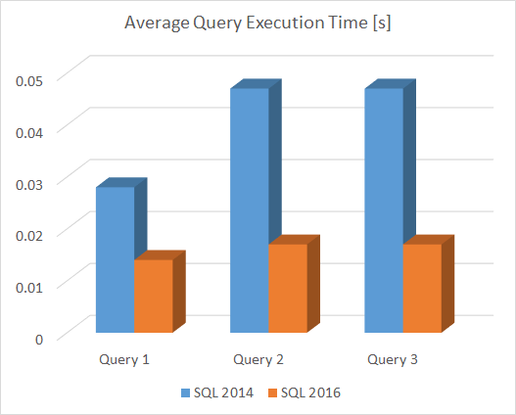
This Stuff is Real
Several major Oil companies…The improved capabilities of Line String and Spatial query’s has shortened the monitoring, visualization and machine learning algorithms cycles allowing them to the same workload in seconds or minutes that used to take days.
A set of designers, cities and insurance companies leverage line strings to map and evaluate flood plains.
An environmental protection consortium provides public, information applications for oil spills, water contamination, and disaster zones.
A world leader in catastrophe risk modeling experienced a 2000x performance benefit from the combination of the line string, STIntersects, tessellation and parallelization improvements.
In one of the tests, average execution times for 3 different queries were recorded, whereas all three queries were using STDistance and a spatial index with default grid settings to identify a set of points closest to a certain location, stressed across SQL Server 2014 and 2016. There are no application or database changes just the SQL Server binary updates

Slide 48
Spatial is Even faster – Index and TVP
Spatial index creation is 2x faster in SQL Server 2016
Special datatypes as TVPs are 15x faster

Slide 49
Encryption and Compression Get a Boost
Encryption
Goal = 90% of standalone workload speed
Scale with parallel communication threads
Take advantage of AES-NI hardware encryption
Compression
Scale with multiple communication threads
Improved compression algorithm

